Slide 1

SQL Data Insights for Jeason USA Bike Store
by Krushant Shah

Slide 2

Company & Database Overview
About Jeason USA
Jeason USA is a premier retail chain specializing in bicycles, accessories, and comprehensive bike maintenance services. Operating stores across the United States, the company leverages the BikeStores database to efficiently track customer relationships, inventory levels, and sales operations.
The database serves as the backbone for managing multi-location retail operations, enabling data-driven decision making across all business functions.

Slide 3

Role of SQL in Business Intelligence
Data Retrieval
Trend Analysis
Extract specific information from complex relational databases with precision and speed
Identify patterns in sales, customer behavior, and seasonal fluctuations over time
Performance Evaluation
Inventory Monitoring
Measure store, staff, and product performance using quantitative metrics
Track stock levels, product movement, and reorder requirements in real-time
SQL transforms raw transactional data into actionable business insights that drive strategic decisions and operational improvements across Jeason USA's retail network.

Slide 4

Project Overview
This project harnesses SQL to analyze Jeason USA Bike Store data comprehensively. Each carefully crafted query addresses a specific business question, extracting valuable insights on sales performance, customer behavior, product trends, and staff effectiveness.
The analysis covers critical business areas including revenue generation, inventory optimization, customer segmentation, and operational efficiency. These insights empower management to make informed decisions that enhance profitability and customer satisfaction.

Slide 5
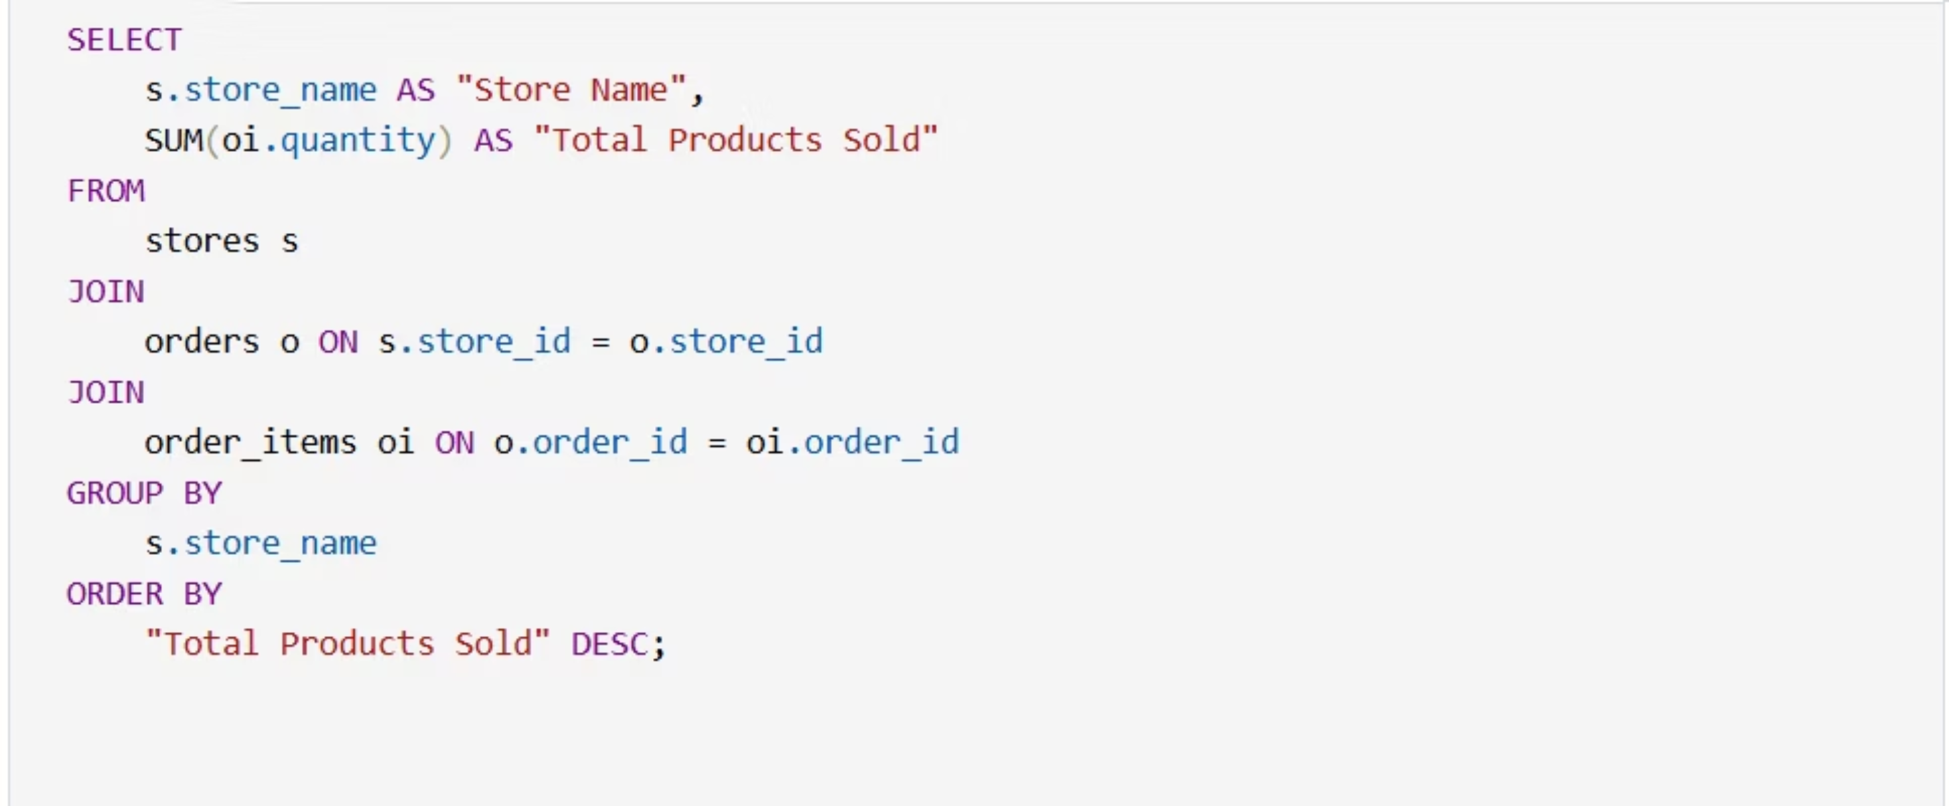
Query 1: Find the total number of products sold by each store along with the store name.

Slide 6
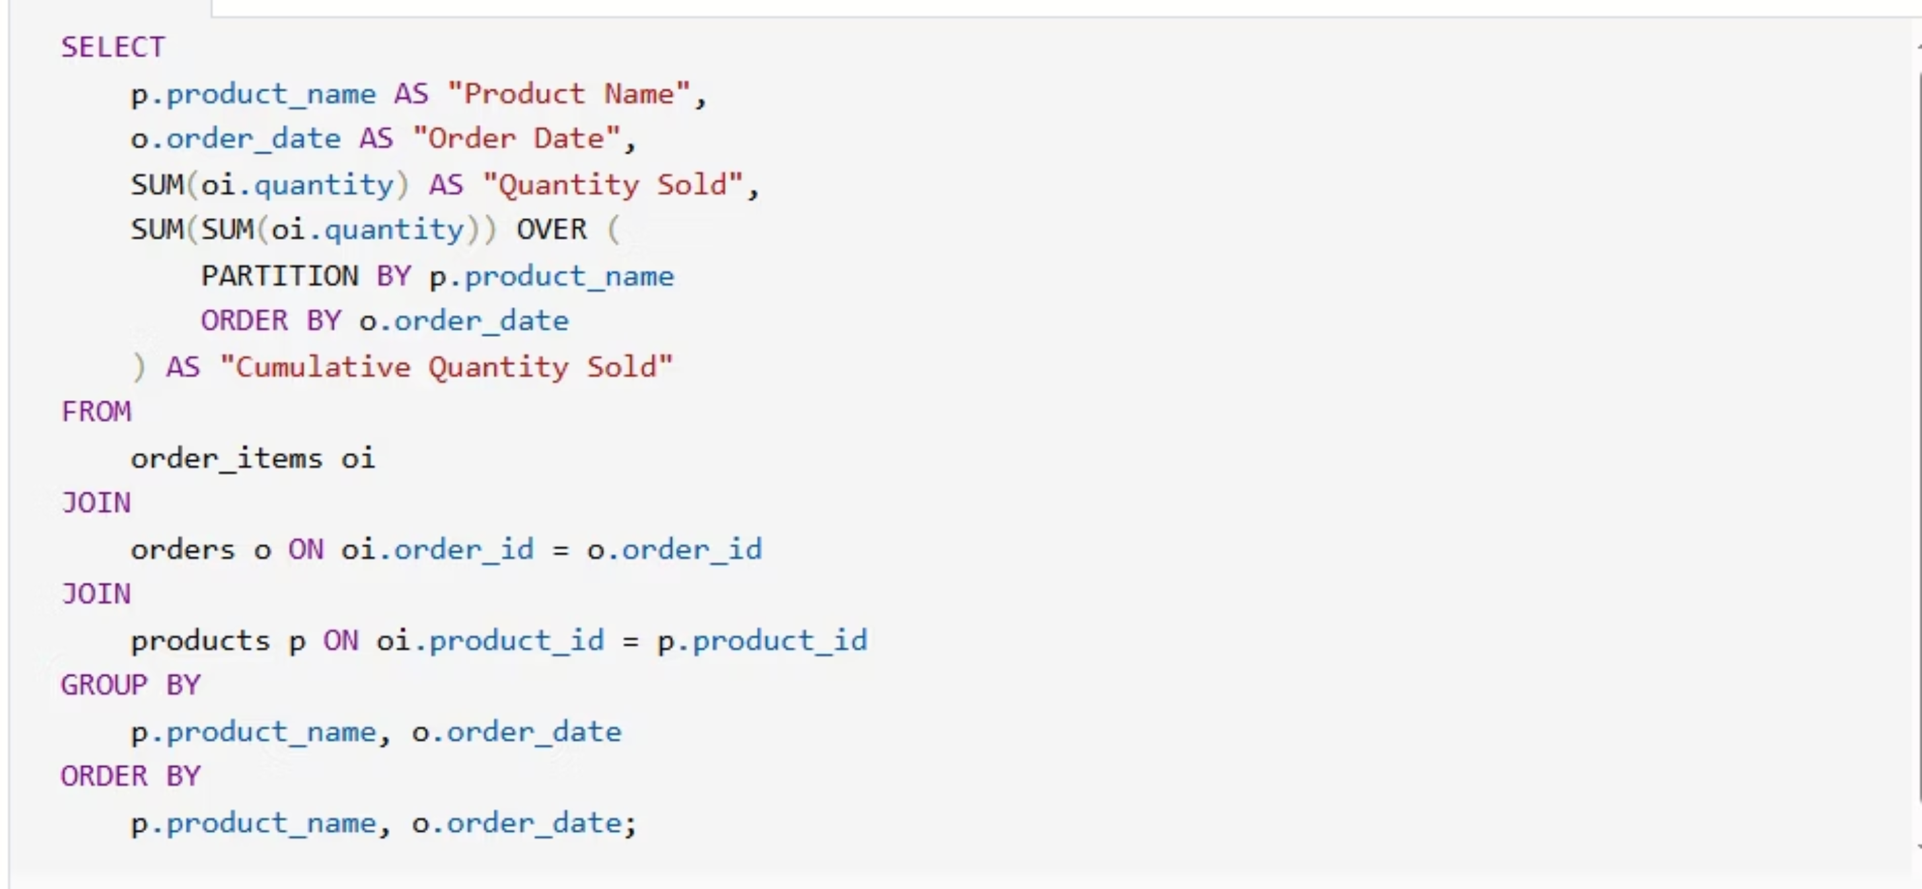
Query 2: Calculate the cumulative sum of quantities sold for each product over time

Slide 7
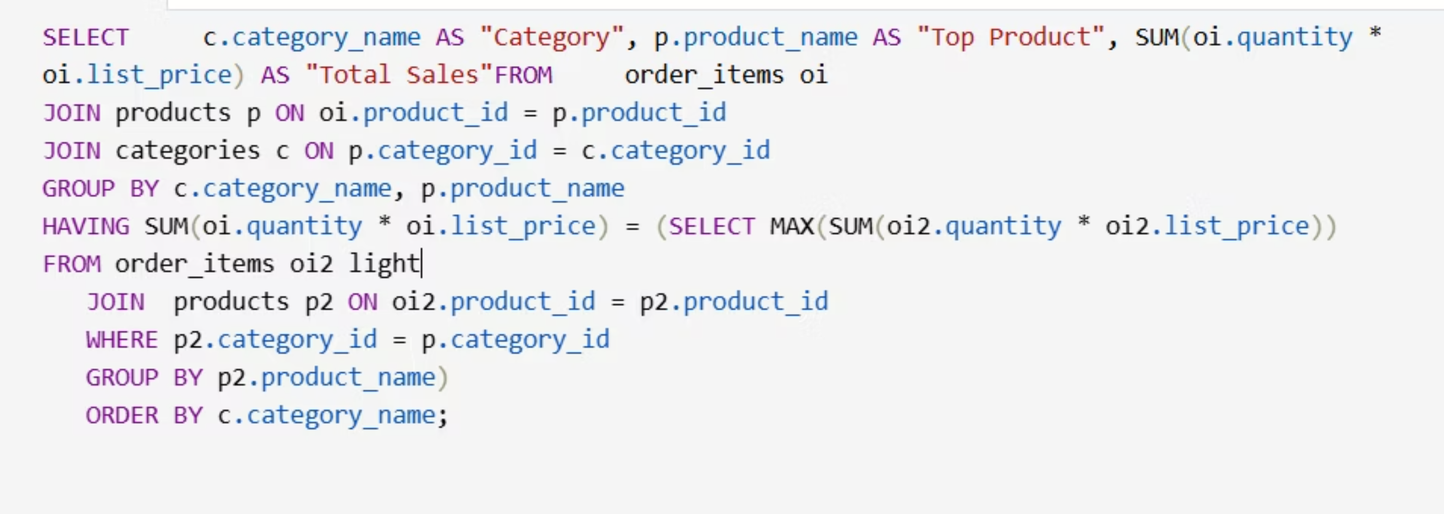
Query 3: Find the product with the highest total sales (quantity × price) for each category.

Slide 8
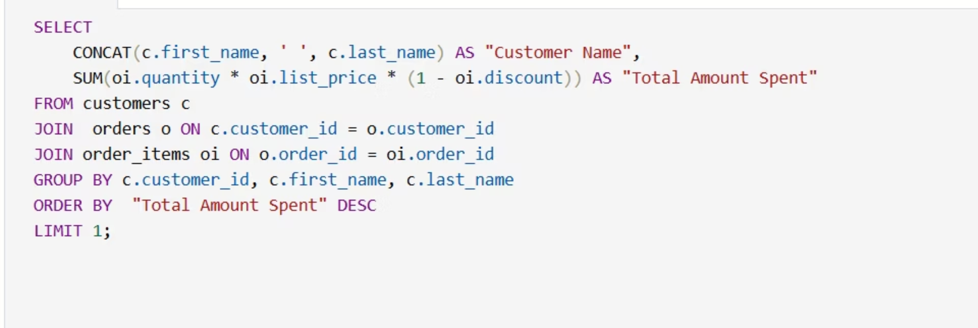
Query 4: Find the customer who spent the most money on orders.

Slide 9
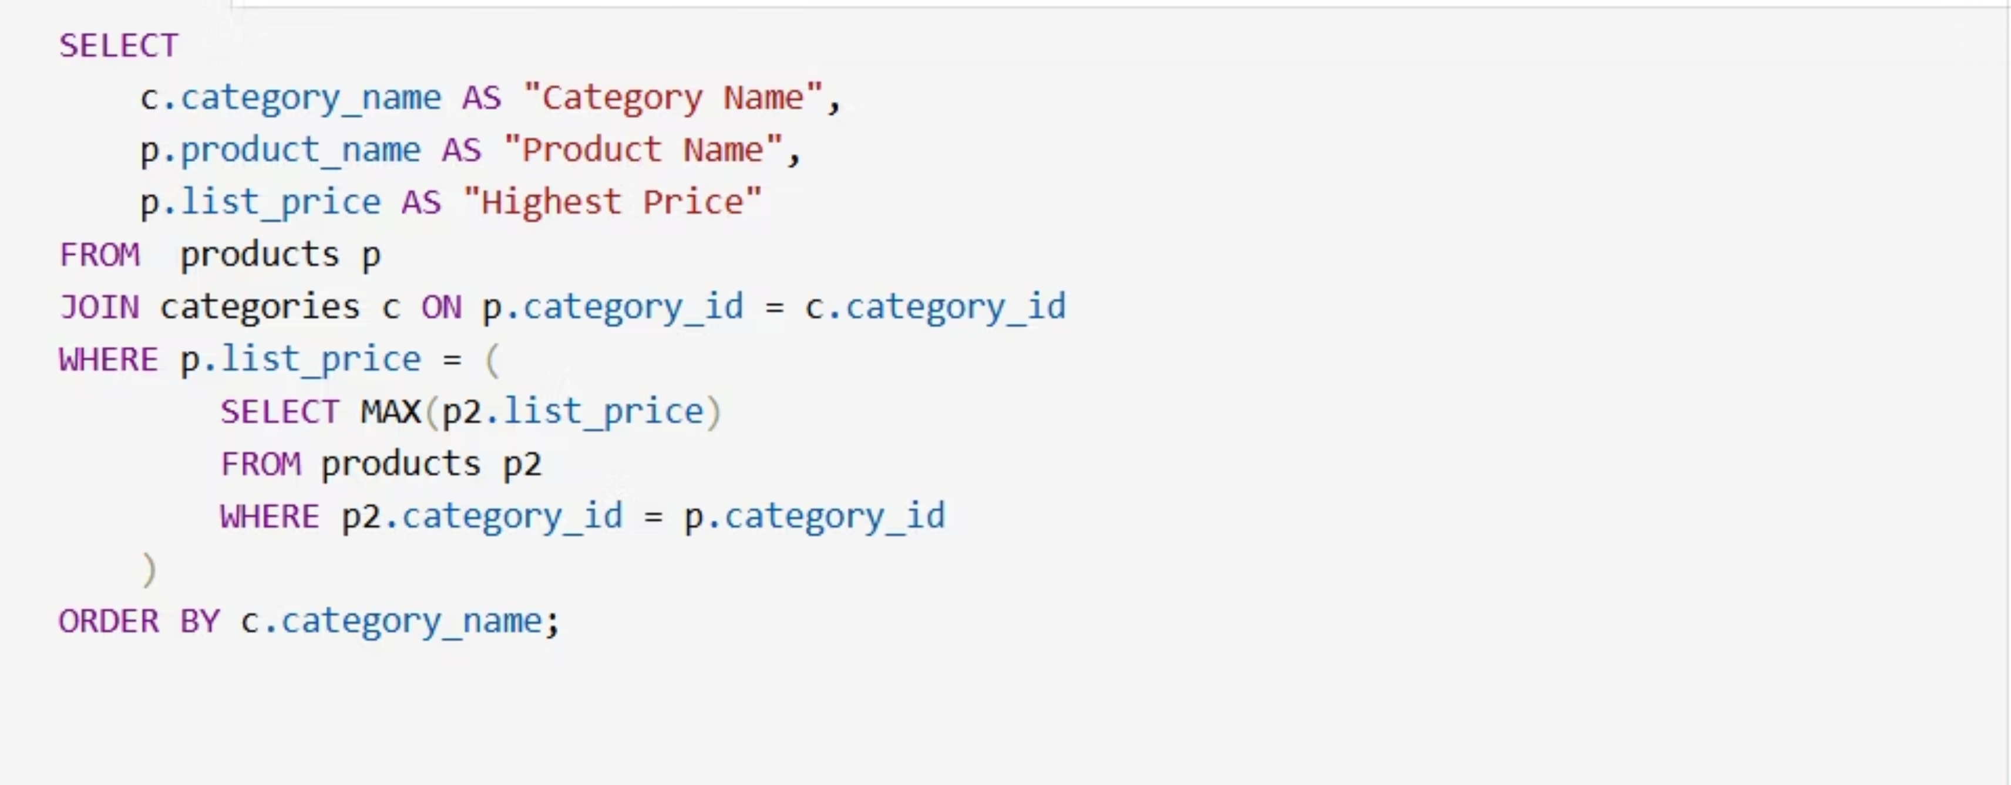
Query 5: Find the highest-priced product for each category name.

Slide 10
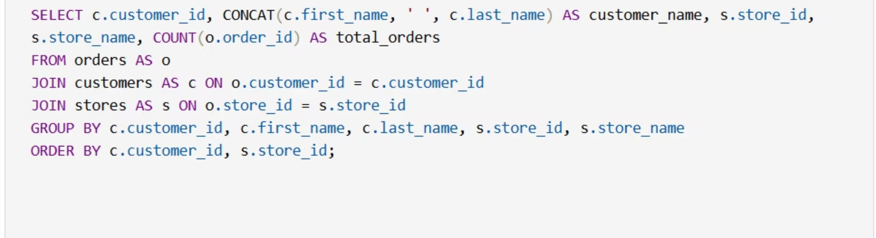
Query 6: Find the total number of orders placed by each customer per store.

Slide 11
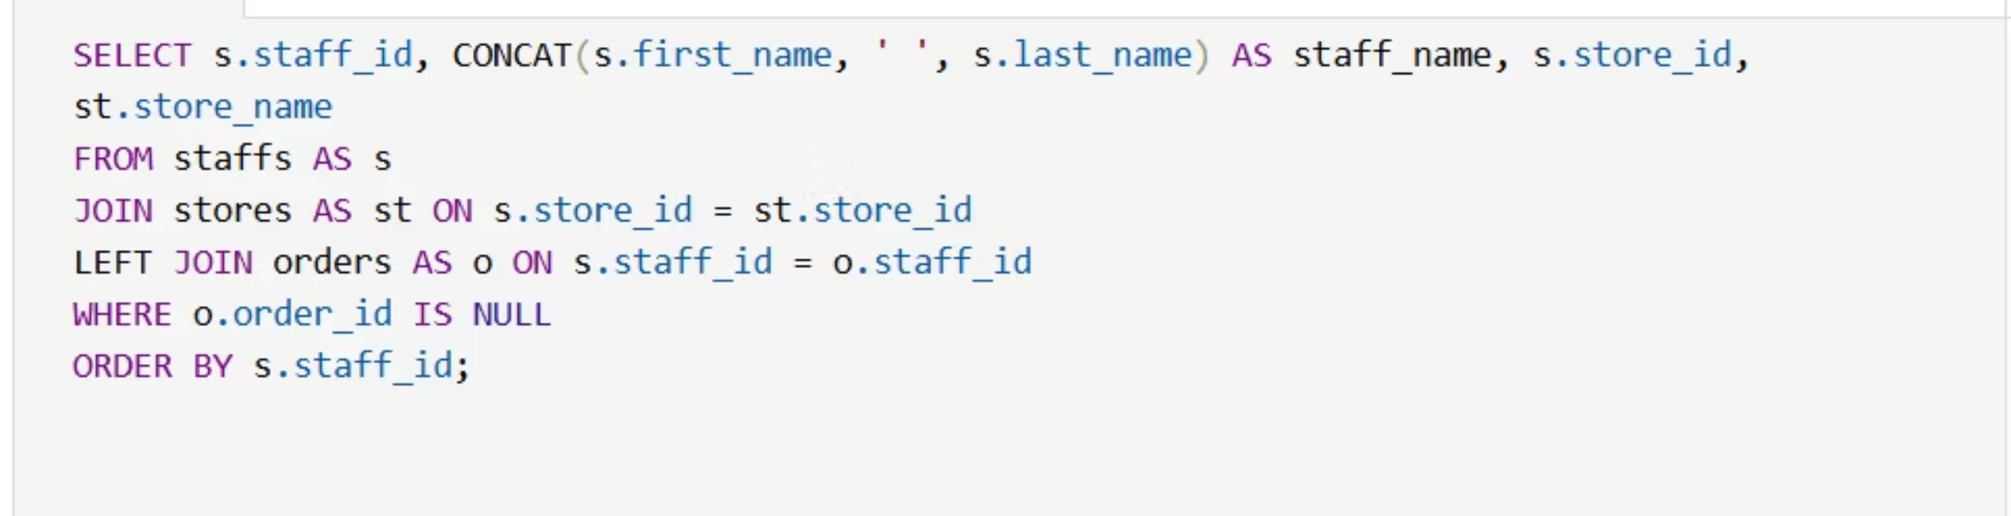
Query 7: Find the names of staff members who have not made any sales.

Slide 12
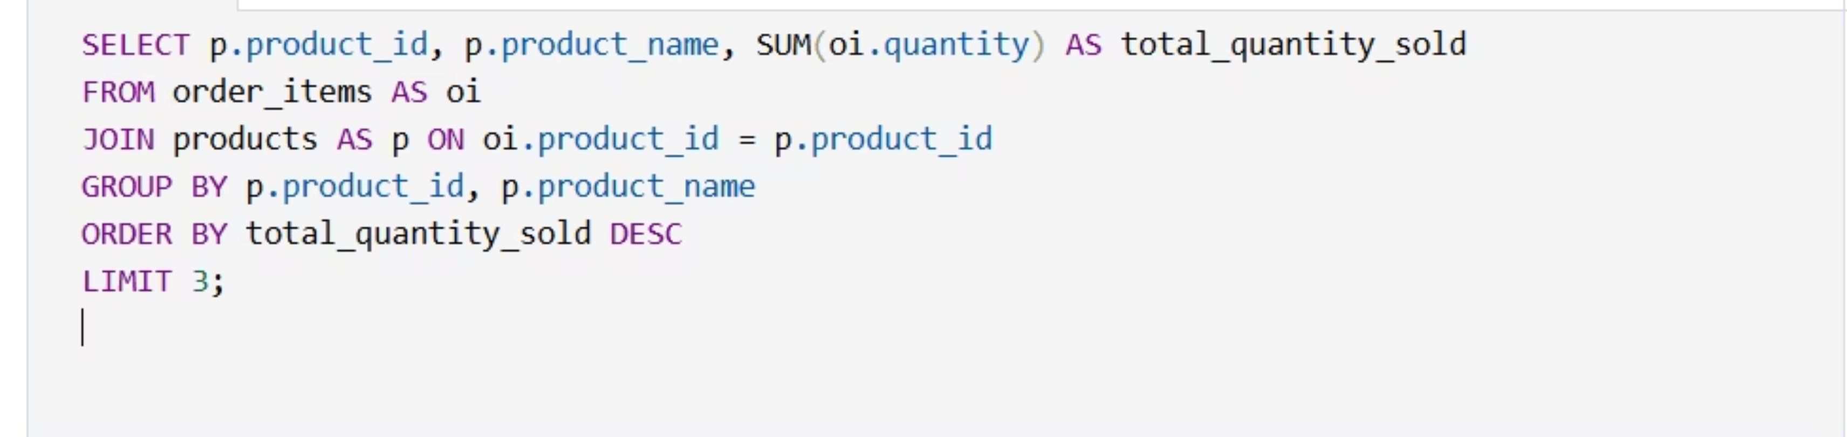
Query 8: Find the top 3 most sold products in terms of quantity.

Slide 13
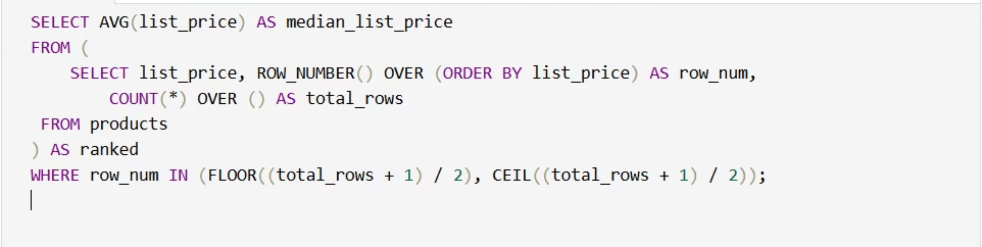
Query 9: Find the median value of the price list.

Slide 14
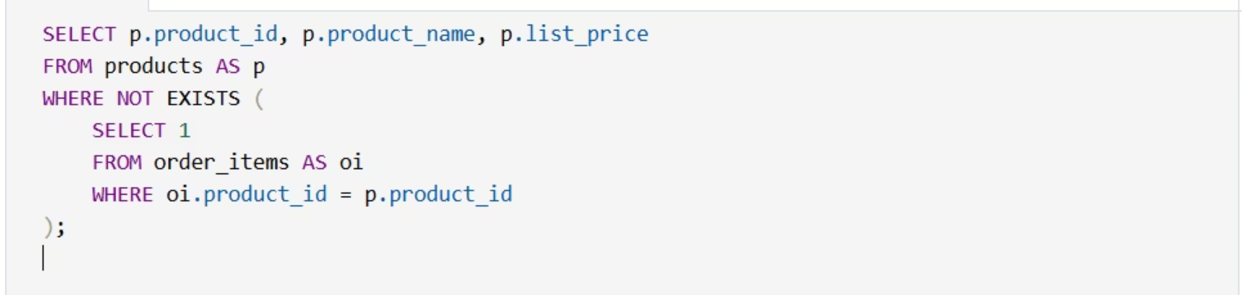
Query 10: List all products that have never been ordered.(use Exists)

Slide 15
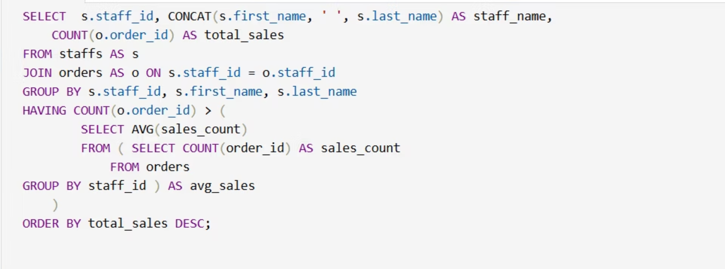
Query 11: List the names of staff members who have made more sales than the average number of sales by all staff members.

Slide 16
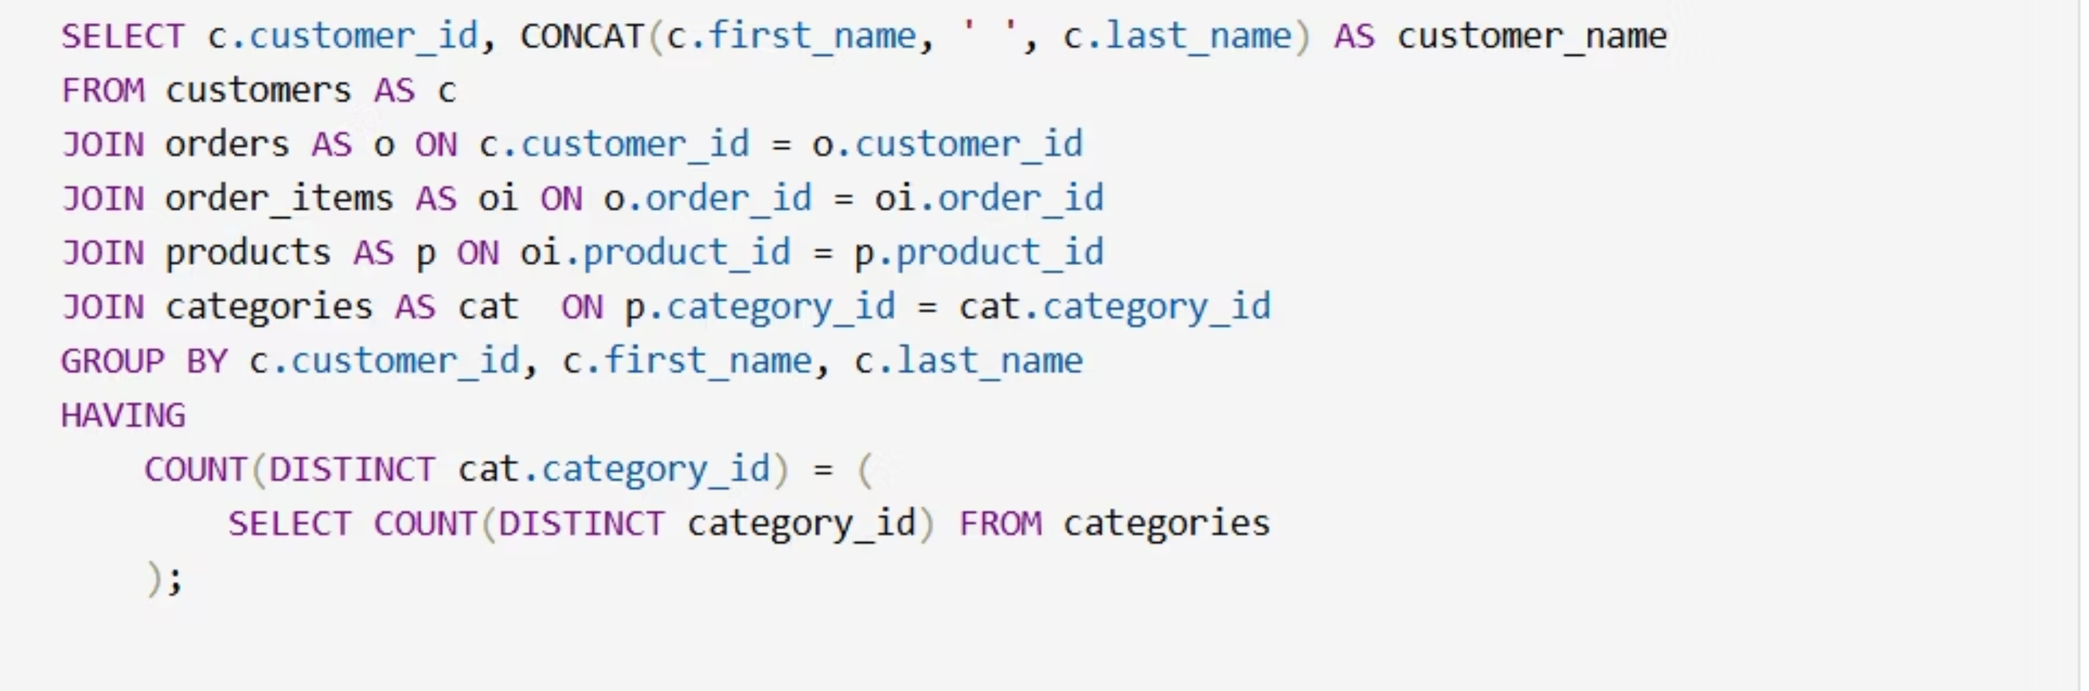
Query 12: Identify the customers who have ordered all types of products (i.e., from every category).

Slide 17
Thank You.

